Slide 1


Basic Details of the Team and Problem Statement
Ministry of Home Affairs
PS Code: 1407
Problem Statement Title: Chatbot based helpdesk for govt employees and departments
Team Name: GovTech Innovators
Team Leader Name: Prashant
Institute Name: Vellore Institute of Technology
Theme Name: Smart Automation
Notes:
Government employees and departments, the backbone of our public administration, often find themselves grappling with complex processes and It can be observed that even to get answers to our basic queries, we have to go through a complex process.
To bridge these gaps and to enhance the government efficiency, avoiding manpower, we present the project: "Enhancing Government Services with a Chatbot-Based Helpdesk."

Slide 2
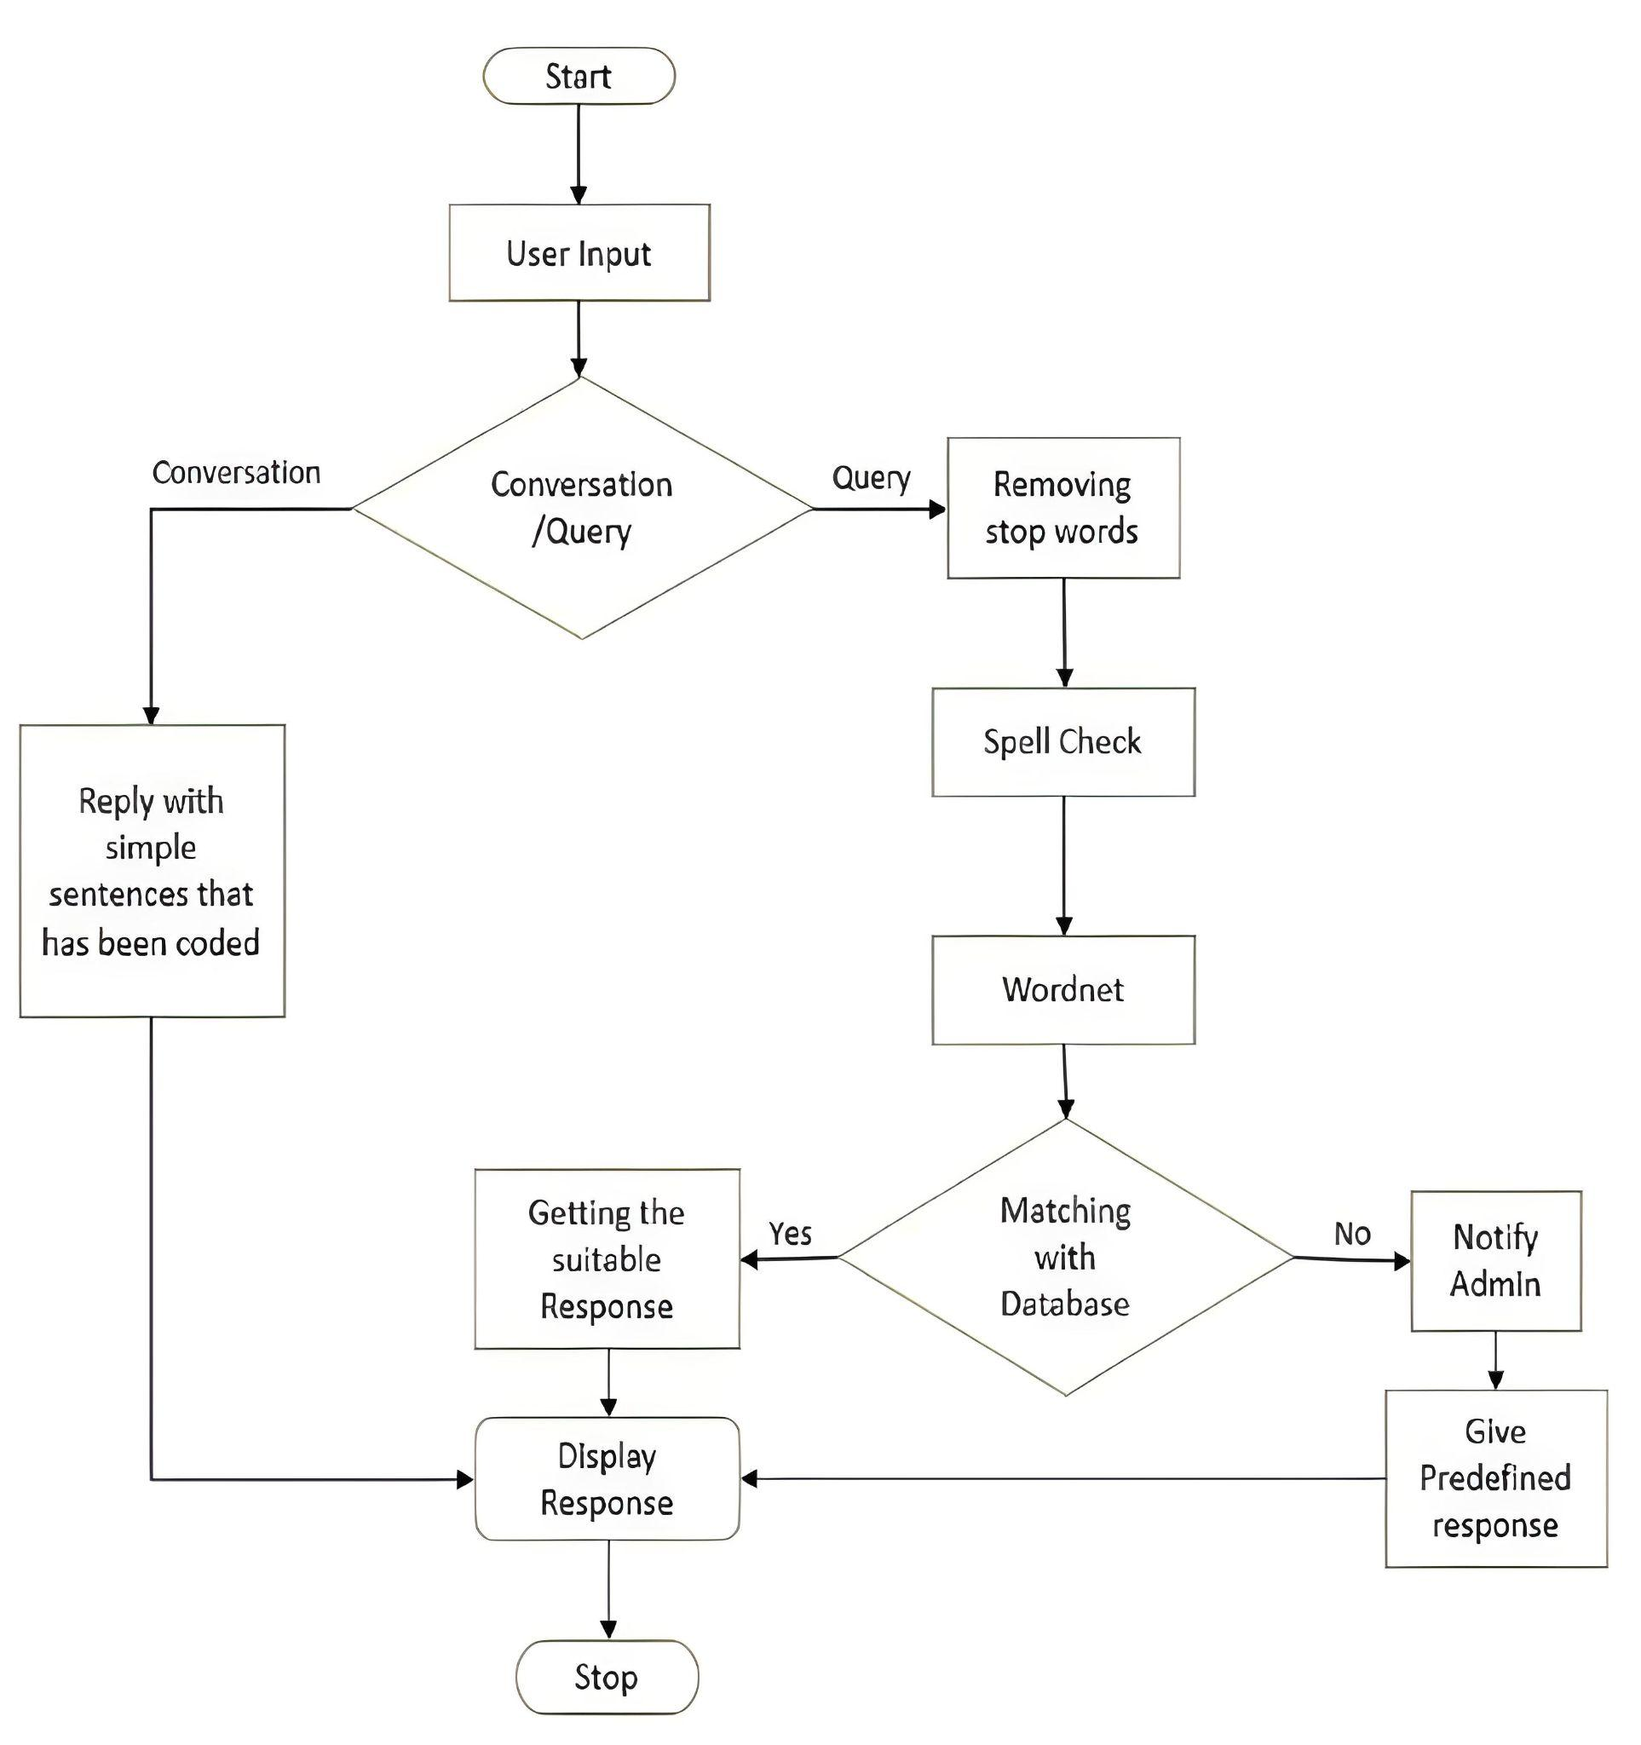
Idea/Approach Details
Our proposed solution is to develop a centralized and department-wise website based chatbot to work as a helpdesk for government employees and departments.
This smart automation tool aims to streamline various business processes, from procurement to implementation, and provide authoritative guidance.
The chatbot will improve productivity, enhance interdepartmental coordination, and boost job satisfaction among government employees, ultimately benefiting citizens indirectly by ensuring efficient government operations
The Data Protection Rights Under General Data Protection Regulation (GDPR)
Technology stack
HTML, CSS, JS for the web interface
Using frameworks for JS and styling the website
Chatbase API integration with gpt-3.5 for training.
Web speech API for voice powered chatbot support
Dynamic Linking for user authentication

Slide 3
Idea/Approach Details
Use Cases:
User Authentication: Allow government employees to log in securely using their credentials to access personalized assistance
Up to date Information: Provide up-to-date information on government policies, procedures, and regulations, ensuring employees are aware of the latest changes.
FAQs and General Queries:
Answer frequently asked questions about various departments, procedures, and common issues.
User Onboarding: Assist new employees with onboarding processes, including paperwork and orientation.
Notifications and Alerts: Send timely notifications and alerts regarding important updates, meetings, or deadlines.
Feedback and Suggestions: Gather feedback from users to continuously improve the chatbot's functionality and the overall support experience.
Analytics and Reporting: Provide department heads with analytics and reports on the usage and effectiveness of the chatbot to make data-driven decisions.
Scalability: The chatbot can easily handle increasing user loads as its popularity grows.
Speech to text: User just have to turn on voice recognition, and it can be used hands free.

Slide 4
Team Member Details
Team Leader Name: Prashant
Branch Btech Year (III)
Team Member 1 Name: Poojan
Branch Btech Year (III)
Team Member 2 Name: Kushal
Branch Btech Year (III)
Team Member 3 Name: Shubh
Branch Btech Year (III)
Team Member 4 Name: Chirag
Branch Btech Year (III)
Team Member 5 Name: Nidhi
Branch Btech Year (III)
Team Mentor 1 Name: Valarmathi B
Category: Academic Expertise: Text-Mining, Data Science, AI/ML, sentimental Analysis Domain Experience (in years): 30
Team Mentor 2 Name: Sudarsan S
Category: Industry Expertise: Text-Mining, Data Science, AI/ML,Robotics, Smart-vehicle Automation Domain Experience (in years): 25

